Slide 1

DEPARTMENT OF COMPUTER SCIENCE & ENGINEERING
Dr. N.G.P. Institute of Technology, Coimbatore – 641048 (An Autonomous Institution) Approved by AICTE, New Delhi & Affiliated to Anna University, Chennai Recognized by UGC & Accredited by NAAC with A+ Grade and NBA (BME, CSE, ECE, EEE and Mechanical)
“EMOTIONAL RECOGNITION USING TEXT&AUDIO”
PRESENTATION BY,
NAMES:
ASWIN.N 710720104011
JANANIKEERTHANA.U 710720104034
JERISH PRINCETON.R 710720104037
SIVAPRAKASH.A 710720104307
UNDER THE GUIDANCE OF ,
GUIDENAME:Mr.SELVARAJ.R
DESIGNATION:Assistant
Professor (SLGR) / CSE

Slide 2
Outline of the Work
Introduction
Problem Definition
Objectives of the work
Existing System
Literature Review(Table Format)
Proposed system
System Design
Methodology
Results & Outcome
Coding ScreenShots
Conclusion

Slide 3
Introduction
Deep learning algorithms have successfully solved machine learning problems.
Machine intelligence can be used to understand and reflect human emotions.
The goal of speech emotion recognition is to predict the emotional content of speech and classify speech according to one of several labels (i.e., happy, sad, neutral, and angry).

Slide 4
Problem Definition
NLP focuses on how computers can analyze, understand, and generate human language data.
NLP enables computers to understand, interpret, and generate natural language data.
NLP uses machine learning, deep learning, and AI to achieve tasks.

Slide 5
Objectives of the Work
Identifying emotion from speech is a non-trivial task pertaining to the ambiguous definition of emotion itself.
Multimodal machine learning models compared to deep learning models.
Light-weight models outperform deep learning, but combining feature sets can complicate the learning process and increase overfitting.

Slide 6
Existing System
Emotion recognition is a challenging task, and extensive reliance has been on models that only use Facial and Audio features in building well-performing classifiers.
AffectNe
SPEAR

Slide 7
Literature Review
Title of Paper | Authors | Year of Publications | Journal/Conference Name | Inference from the paper
Multi-level Speech Emotion Recognition Based on HMM and ANN | Mao, X., Chen, L., Fu, L | 10-08-2020 | IJRESM | . In: WRI World Congress on Computer Science and Information Engineering,
“Audio-based emotion estimation for interactive robotic therapy for children with autism spectrum disorder,” in Proc. | J. Kim, P. Azzi, M. Jeon, A. M. Howard, and C. H. Park, | 04-04-2021 | IJARCCE | In this paper we learnt about various software deeply invloved in the system.
Emotional chatting machine | Hao Zhou, Minlie Huang, Tianyang Zhang, Xiaoyan Zhu, and Bing Liu | 12-08-2018 | JETIR | Emotional conversation generation with internal and external memory
Features, classification schemes, and databases | M. El Ayadi, M. S. Kamel, and F. Karray | 07-03-2018 | JMESTN | In this paper we learnt about the various security measures,GSM call ,operations involved in camera positioning.

Slide 8
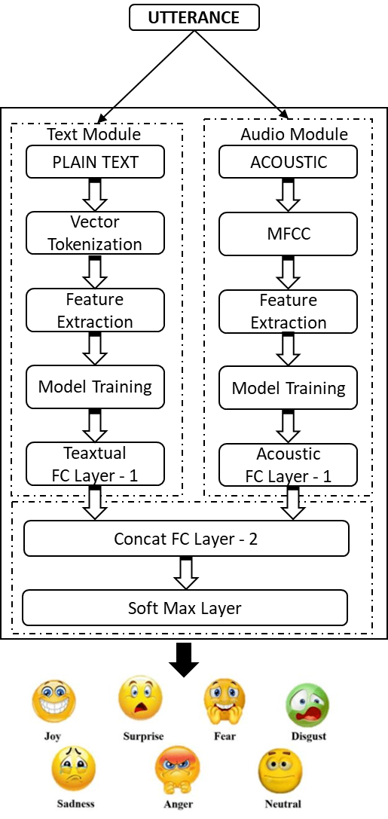
Proposed System-Architectural Design of the System

Slide 9
Proposed System-Methodology
Deep dual recurrent encoder model uses text and audio signals to better understand speech data.
Dual Recurrent Neural Network combines audio and text to predict emotion class.
Understanding human emotions through machine intelligence.
Building robust emotion classifiers to develop emotionally aware intelligence.

Slide 10
Results and Outcome
Smart locks provide security and convenience for homeowners.
Smart locks eliminate the need for a key to gain access.
Smart door technology provides convenience and security, using Android phone and Raspberry Pi.

Slide 11
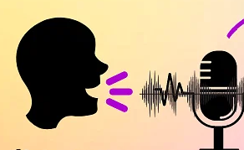
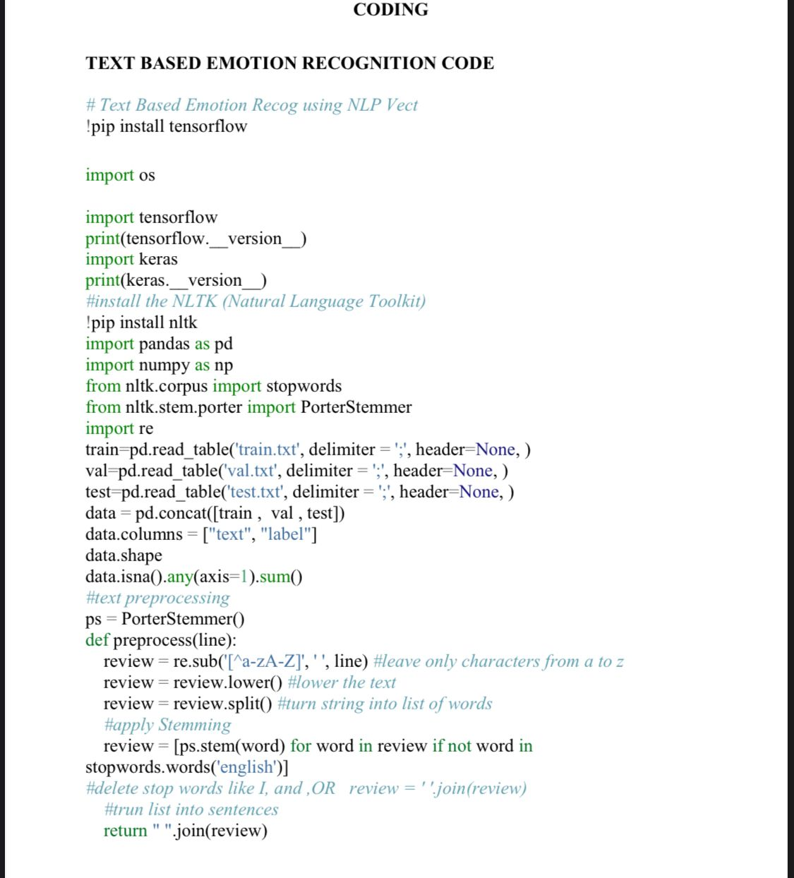
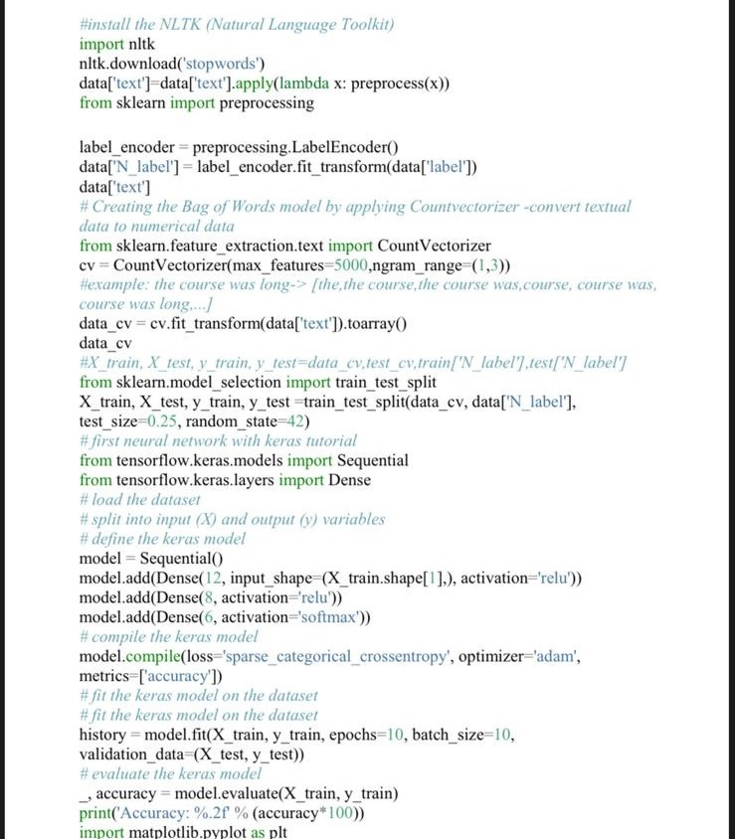


Coding Screenshots

Slide 12
Conclusion
Emotion recognition has seen progress in recent years, but there are still challenges to be addressed to make it more effective and reliable.
Emotion recognition algorithms are still limited, but there is potential for further development.
Emotion recognition advances, new applications and use cases expected.

Slide 13
Thank you
Queries ?

